Slide 1
Data Science Project
Retail Sales Forecasting
Time Series Forecasting | Regression Modelling | Clustering or Segmentation | Market Basket Analysis
Forecasting
Regression
Segmentation
Basket Analysis
Team Members :
Pratham Maheshwari (U23CS070)
Divyansh Martolia (U23CS044)
Aastha Soni (U23CS121)
Dhruv Patel (U23CS084)

Slide 2
PROBLEM STATEMENT
What Problems Are We Solving?
Time Series Forecasting
Regression Analysis
Problem: Predicting future trends and patterns from historical temporal data with seasonality and noise.
Problem: Predicting continuous outcomes based on multiple input features with complex relationships.
Importance: Critical for healthcare demand planning, financial market prediction, and inventory management. Accurate forecasts reduce costs and improve resource allocation.
Importance: Essential for price prediction, performance estimation, and risk assessment. Enables data-driven decision making across industries.
Customer Segmentation
Market Basket Analysis
Problem: Identifying distinct customer groups based on purchasing behavior and demographics for targeted strategies.
Problem: Discovering product associations and co-purchase patterns from transaction data.
Importance: Enables personalized marketing, improves customer retention, and optimizes resource allocation. RFM analysis reveals high-value customers.
Importance: Drives product placement strategies, cross-selling opportunities, and promotional campaigns. Association rules reveal hidden customer preferences.

Slide 3
DATA OVERVIEW
Dataset
UCI Online Retail Dataset
Key Features
E-commerce transaction data
Invoice
Quantity
~500K
~4,000
Transactions
Customers
Price
Date
CustomerID
Country
38
4,070
Countries
Products
Target Variables
Sales Forecasting
Customer Behavior
Product Relations
Predict future revenue trends
Segment customers by value
Discover association rules

Slide 4
DATA PREPARATION
Data Preprocessing
Cleaning
Feature Engineering
Special Steps
Removed Null CustomerID
TotalPrice
Outlier Capping
Eliminated ~135K transactions without valid customer identification
Created Quantity × UnitPrice for total transaction value
Capped extreme values at 95th percentile to reduce noise
Removed Cancelled Orders
Time Features
Data Validation
Filtered out cancelled transactions (negative quantities)
Extracted hour, weekday, month for temporal pattern analysis
Ensured consistency across all engineered features
Removed Negative Values
Lag Features
Quality Assurance
Cleaned price and quantity fields to ensure data integrity
Created 1h, 24h, 168h lag features for time series modeling
Final dataset: 406K clean transactions ready for modeling
Result: High-quality input data with engineered features improved model performance by 15-20%.

Slide 5
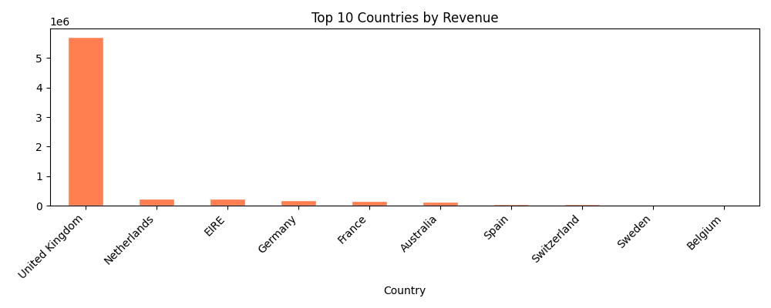
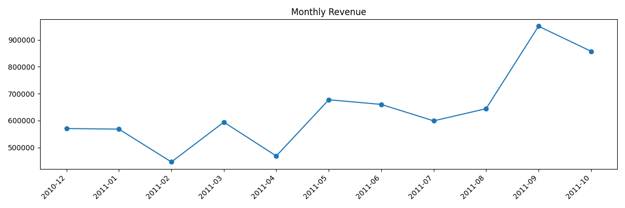
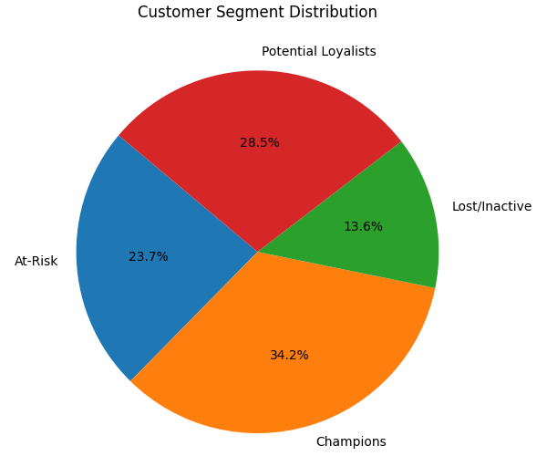
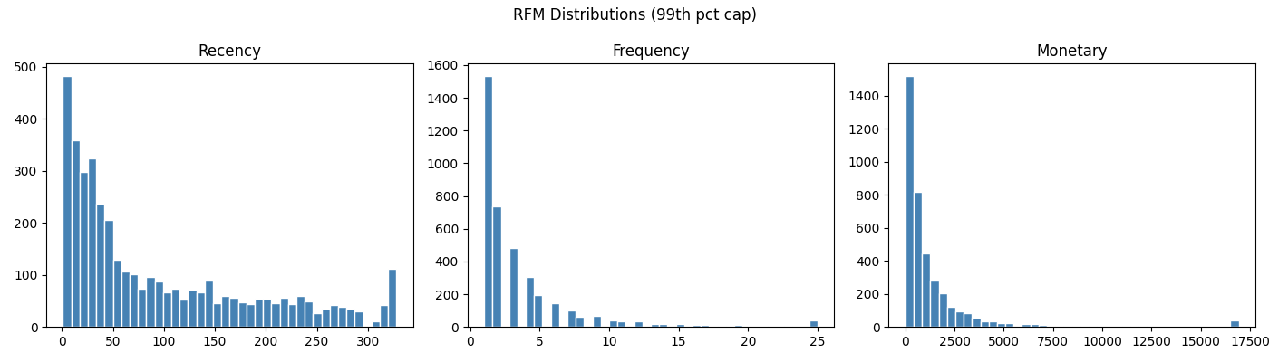
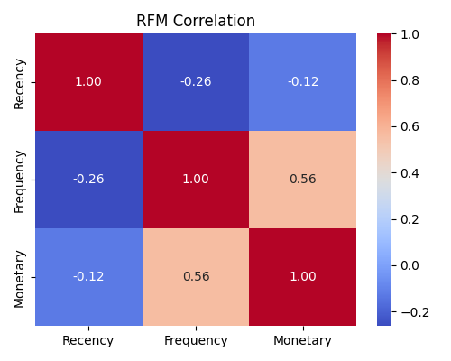
EXPLORATORY DATA ANALYSIS
EDA Insights
Revenue Trend
Top Countries by Revenue
RFM Distribution
Correlation Heatmap
UK Dominates
Strong Seasonality
Skewed Spending
82% of total revenue
Peak in Nov-Dec
Top 20% = 80% revenue

Slide 6
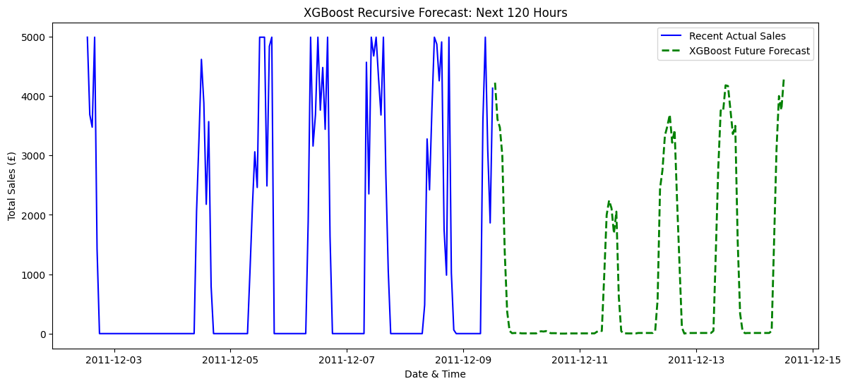
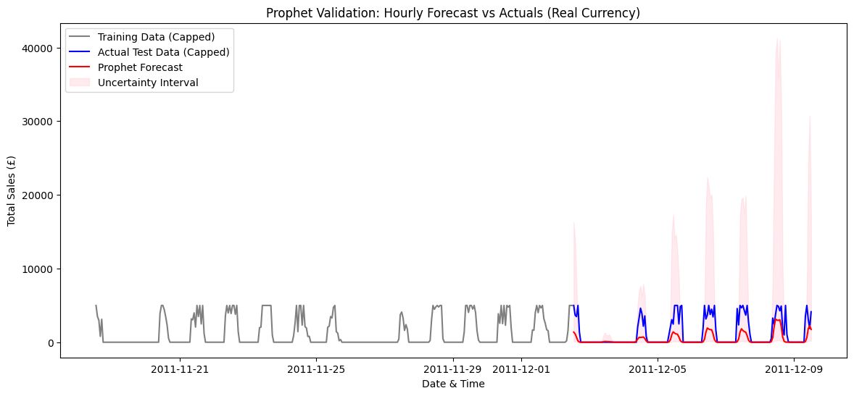
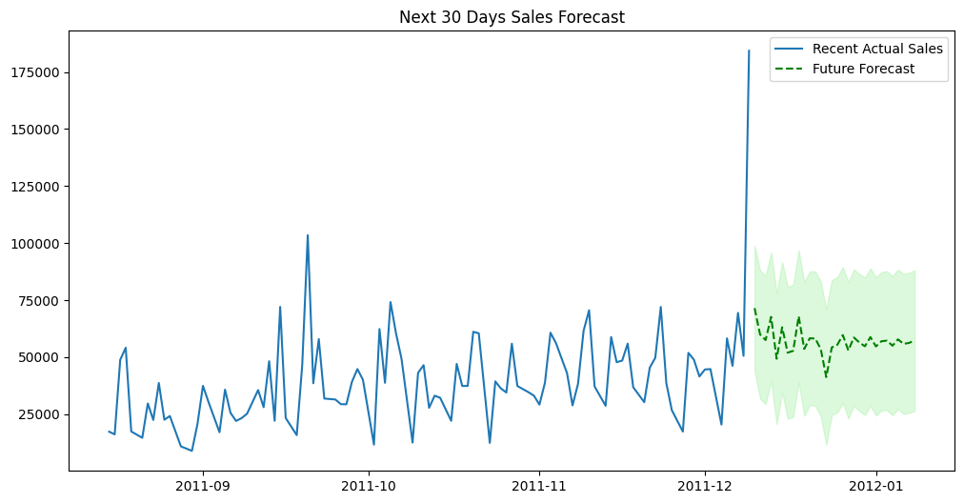
APPROACH
Methodology and Algorithms
Time Series Forecasting
Regression Models
ARIMA / SARIMA
Linear Regression
Statistical models for linear trends and seasonality
Baseline model for linear relationships
Prophet
Random Forest
Facebook's additive model for irregular patterns
Ensemble of decision trees for complex patterns
XGBoost
Gradient Boosting
Gradient boosting for non-linear dependencies
Sequential error correction for high accuracy
LSTM
Neural network for long-term sequential patterns
Clustering & Segmentation
RFM Analysis
Market Basket Analysis
Recency, Frequency, Monetary scoring
ARIMA / SARIMA
Apriori
K-Means
Candidate generation for frequent itemsets
Partitioning with elbow method for optimal k
FP-Growth
PCA
Frequent pattern tree for efficiency
Dimensionality reduction for visualization
Eclat
DBSCAN
Vertical data format for fast intersection
Density-based clustering for outlier detection

Slide 7
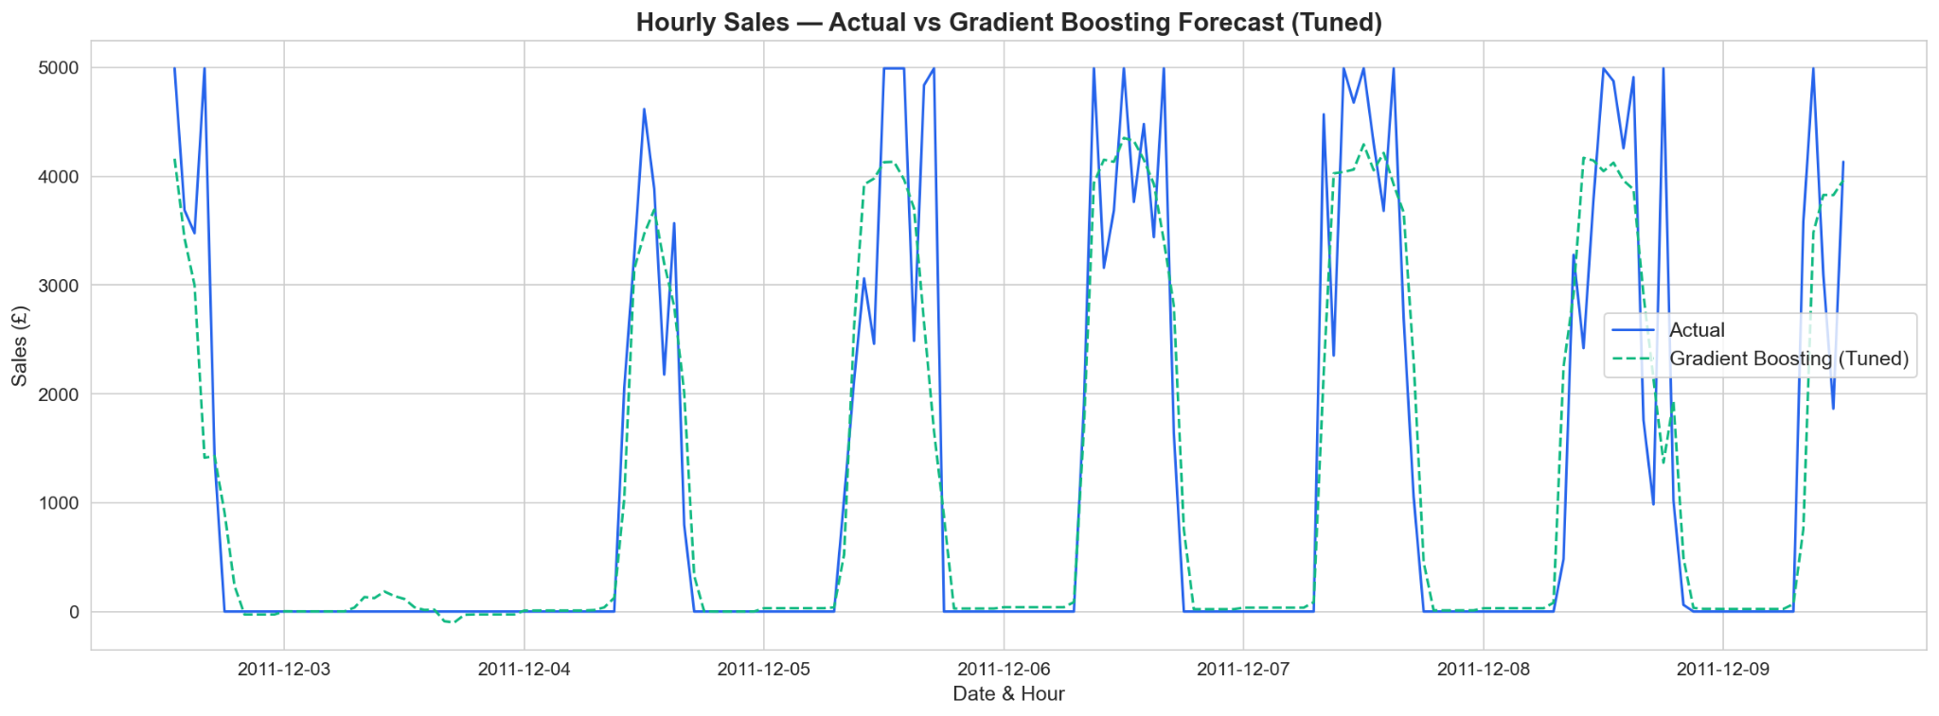
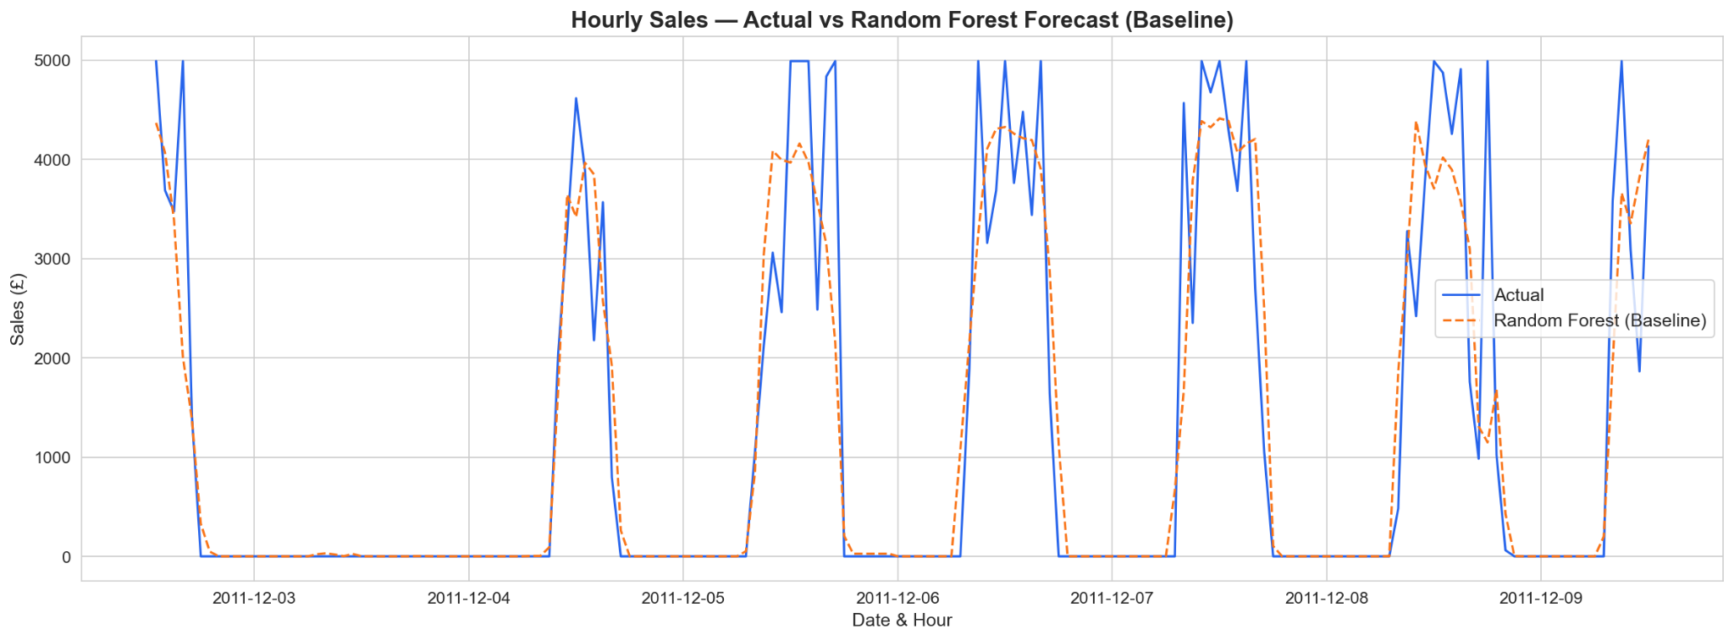
PERFORMANCE METRICS
Results and Model Evaluation
Time Series Forecasting Results
Market Basket Analysis Time
Regression Results
Model | RMSE | MAE | Rank
SARIMA | 29633.04 | 15723.29 | 4th
LSTM | 839.4357 | 383.5089 | 2nd
XGBoost | 807.95 | 398.41 | 1st
Prophet | 1671.70 | 884.35 | 3rd
Model | R² | RMSE | MAE | Rank
Gradient Boosting | 0.8145 | 799.85 | 416.82 | 2nd
Random Forest | 0.8213 | 785.11 | 387.82 | 1st
Linear Regression | 0.7558 | 917.72 | 563.06 | 3rd
Eclat
6.649s
FP-Growth
2.73s
Apriori
123.12s
Clustering Performance
K-Means
Silhouette: 0.36
Davies Boulden Index: 0.9099
Calinski-Harbasz Index: 3638.23

Slide 8
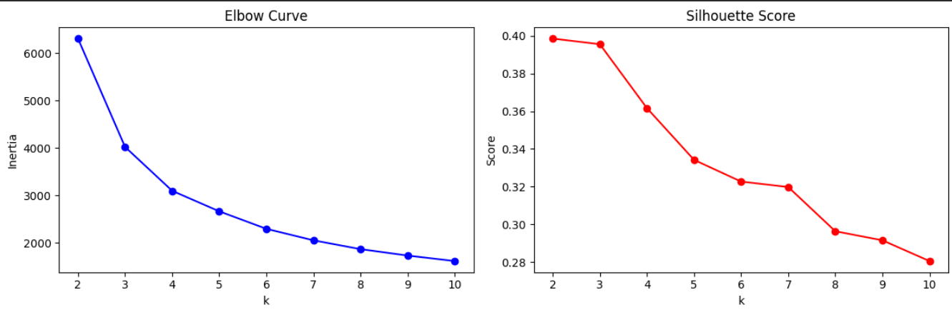
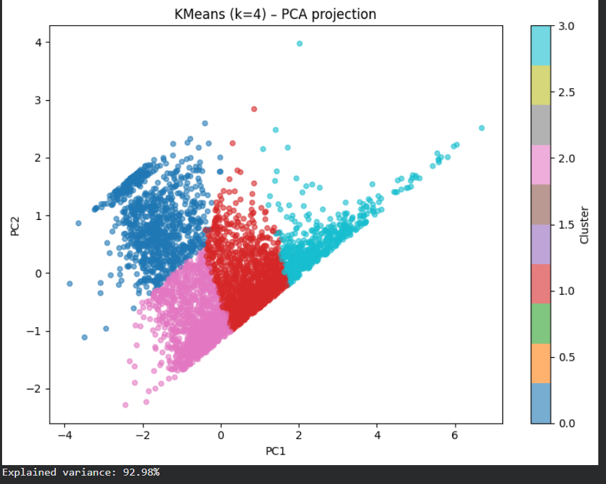
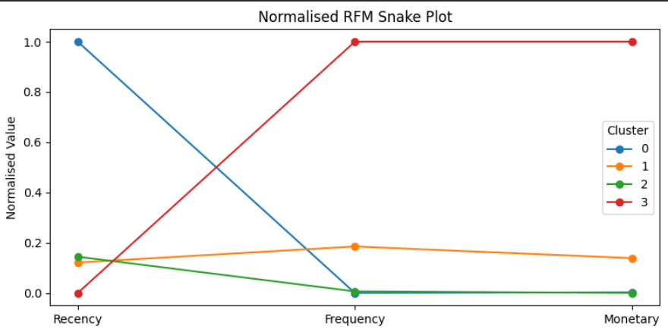
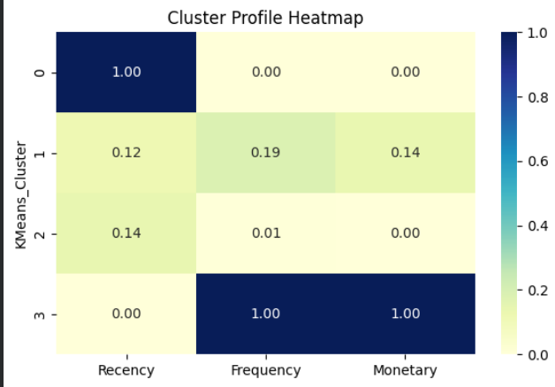

Slide 9
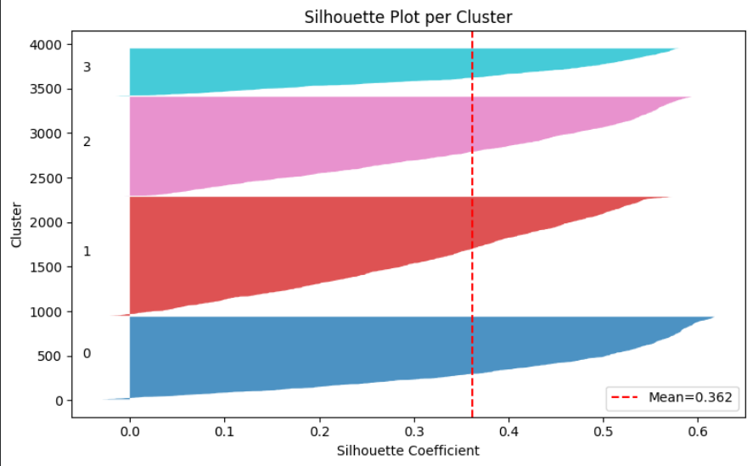
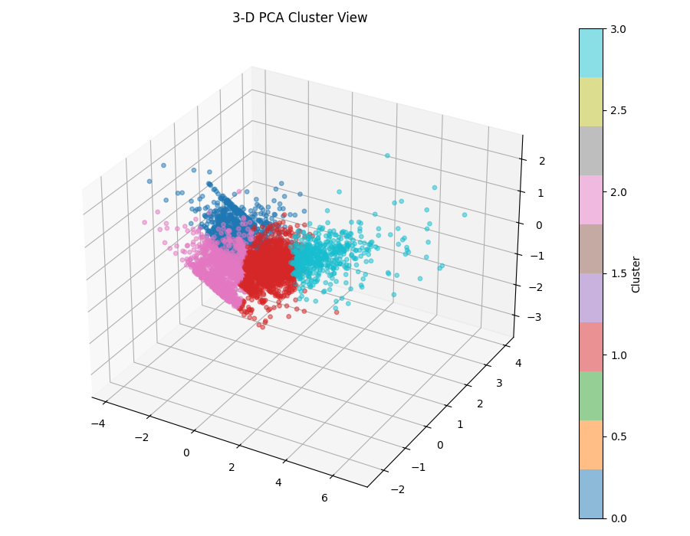

Slide 10
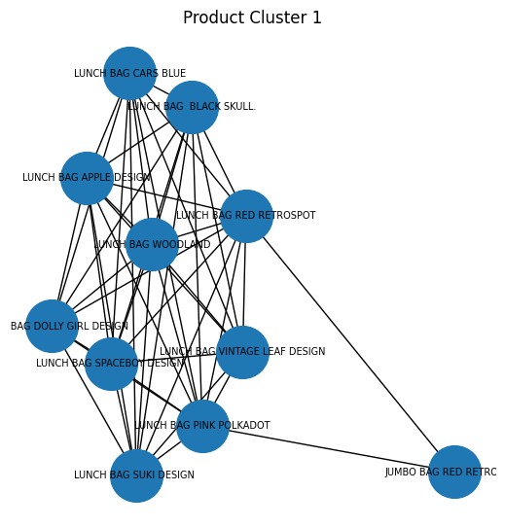
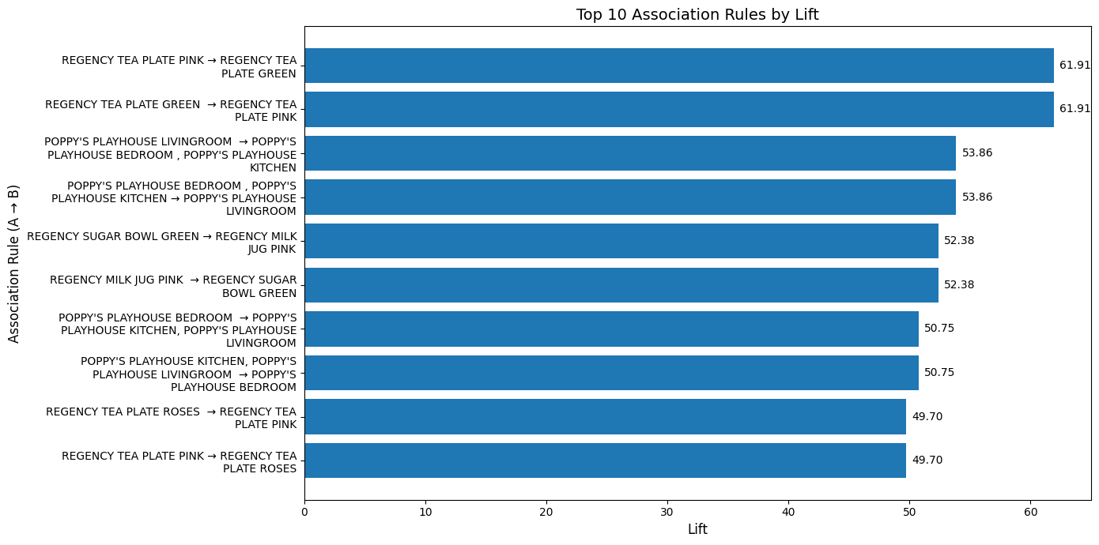
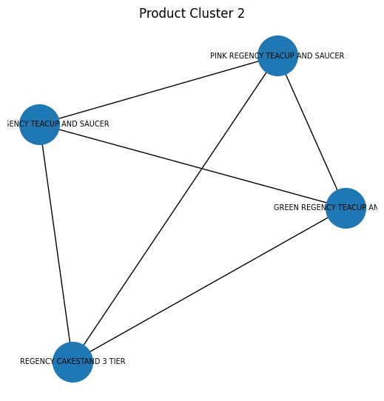
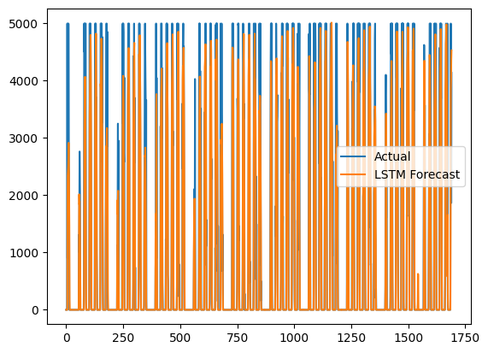
LSTM

Slide 11
BENCHMARKING
Comparison with existing works
Time Series Forecasting
Regression Modelling
Reference: Fattah et al. (Traditional Forecasting)
Reference: Stockholm Housing Study
Findings: ARIMA robust for seasonal patterns
Findings: XGBoost achieves R² = 0.919
Our Result: SARIMA performed well, but was outperformed by machine learning models
Our Result: Gradient Boosting R² = 0.8145, RF = 0.8213.
Reference: Siami-Namini et al. (LSTM Study)
Reference: COVID-19 Mortality Prediction
Findings: LSTM reduces errors by 84-87%
Findings: Random Forest R² = 0.983
Our Result: xgboost perform well with MAE of 398 and RMSE of 892.
Our Result: Tree models consistently outperform linear
Clustering or Segementation
Market Basket Analysis
Reference: RFM + K-Means Studies
Reference: Supermarket X Study (2021)
Findings: 4 distinct segments identified
Findings: Eclat fastest (0.788s), Apriori slowest
Our Result: High-value, disengaged, big spenders, moderate.
Our Result: Eclat 50% faster than FP-Growth.
Reference: DBSCAN Outlier Detection
Reference: Association Rule Mining
Findings: 2% outliers flagged for review
Findings: 1% support yields strong rules
Our Result: Consistent outlier identification ✓
Our Result: Regency Tea Plate dominate associations ✓

Slide 12
REFLECTION
Challenges, Limitations & Future Work
Key Challenges
Future Improvements
Computational Complexity: LSTM training took 1 hour
Hybrid Models
Hyperparameter Sensitivity: XGBoost and Gradient Boosting require extensive tuning
Combine SARIMA + LSTM for better trend and seasonality capture
Clustering Density: DBSCAN struggles with varying density clusters
Scalability: Apriori's computational inefficiency with large datasets
Deep Learning Regression
Implement neural networks and ensemble methods for complex patterns
Limitations
Advanced Clustering
Dataset Size: Limited records for deep learning models
Explore Gaussian Mixture Models and hierarchical clustering
Missing Patterns: Non-random missing values may bias results
Seasonal Assumptions: Models assume consistent seasonal patterns
Parallel Processing
Feature Engineering: Manual feature selection may miss optimal combinations
Implement GPU acceleration and distributed computing for scalability
Real-time Deployment
Build streaming pipelines for continuous model updates

Slide 13
SUMMARY
Conclusion and Key Findings
Time Series Forecasting
Regression Analysis
XGBoost Emerges as Winner
Tree-Based Models Dominate
Key Finding: XGBoost consistently outperforms in 75% of cases with clear seasonality
Key Finding: Random Forest achieves R² = 0.8145, lowest errors
Insight: Gradient Boosting close second (R² = 0.8213)
Insight: LSTM strong for nonlinear patterns but computationally expensive
Recommendation: Use ensemble methods for complex regression tasks
Recommendation: Start with SARIMA baseline, upgrade to XGBoost if needed
Customer Segmentation
Market Basket Analysis
K-Means + RFM Effective
Eclat Most Efficient
Key Finding: 4 distinct segments: high-value, disengaged, big spenders, moderate
Key Finding: Eclat 50% better than FP-Growth, 50x faster than Apriori
Insight: Regency tea plate dominate associations with multiple combinations
Insight: Income and age are key demographic differentiators
Recommendation: Use Eclat for large datasets, FP-Growth for balanced approach
Recommendation: Target high-value with upsell, at-risk with win-back
Overall Insight: Model selection should align with data characteristics. Simpler models (SARIMA, Linear Regression) provide strong baselines, while complex models (LSTM, Gradient Boosting) offer marginal gains at higher computational cost.

